Slide 1
Clear Vision - Online Glasses Selling Company

Slide 2
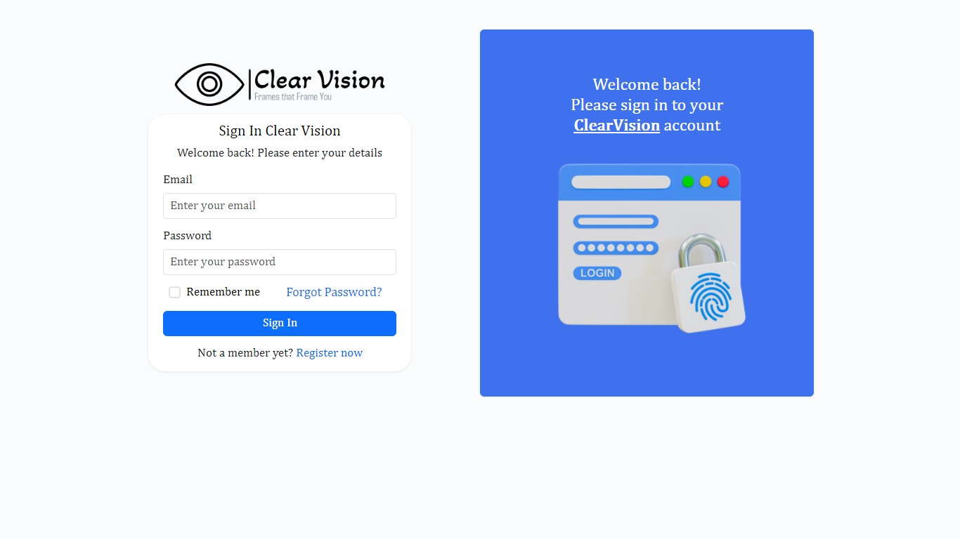
Login Page
This is the login page for Clear Vision where users can sign in with their email and password to access their accounts.

Slide 3
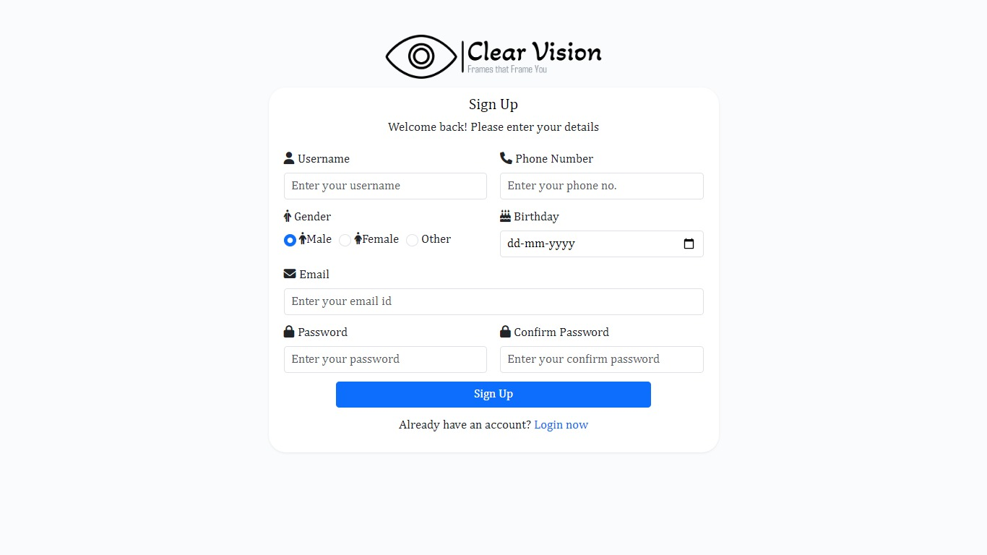
Register Page
This is the registration page where new users can sign up by entering details such as username, email, phone number, and password.

Slide 4
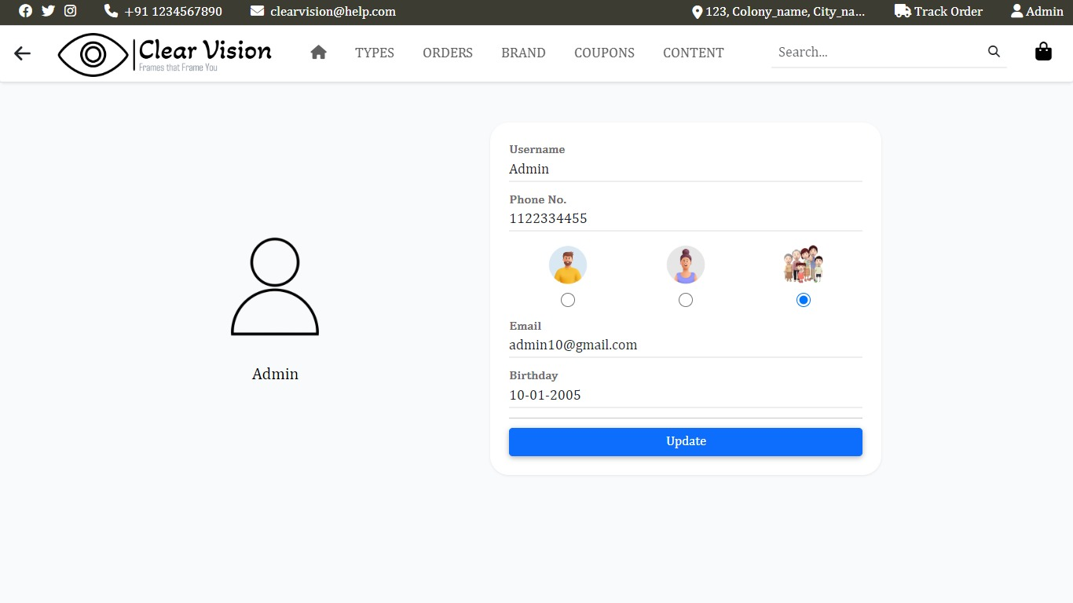
User Profile
All details about users

Slide 5
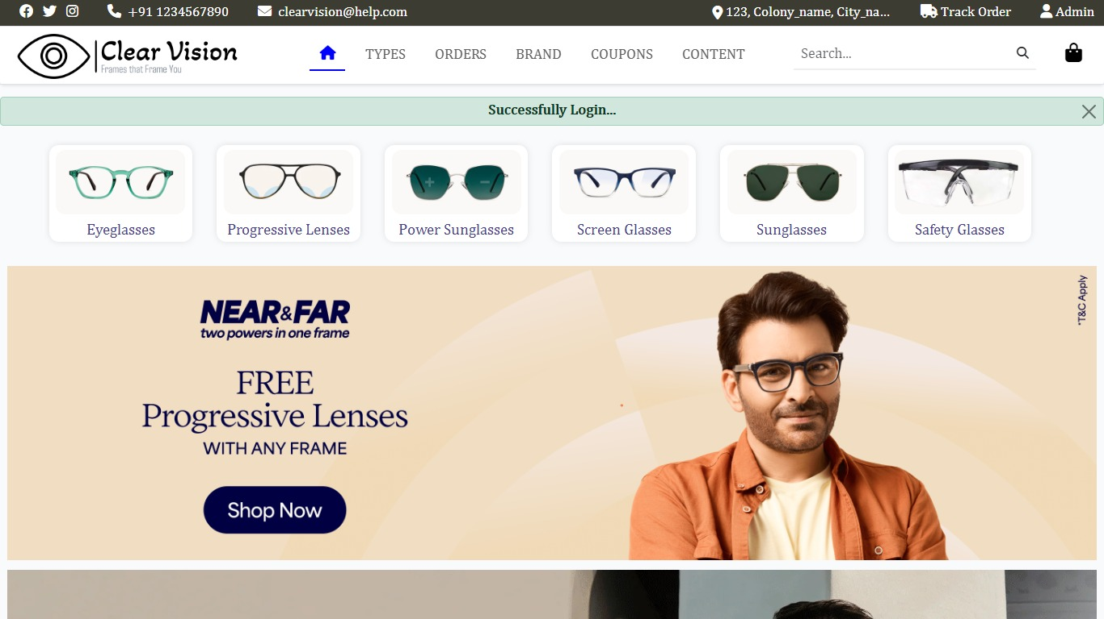
User Dashboard
User Dashboard content show our Website products and many options

Slide 6
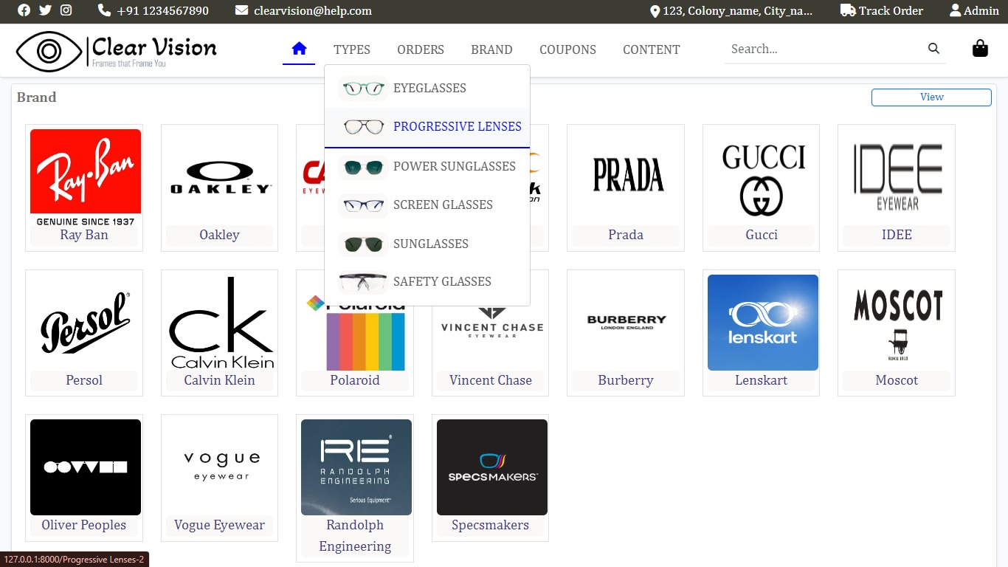
Categories Types
Product selection by users include many types such as eyeglasses, progressive lenses, power sunglasses, screen glass, normal sunglasses and safety glasses

Slide 7

Brands
Our Collaborations with brands like Ray Ban , Oakley , Fastrack and many more

Slide 8

Coupons
Coupons are apply during shopping our products so shop first

Slide 9
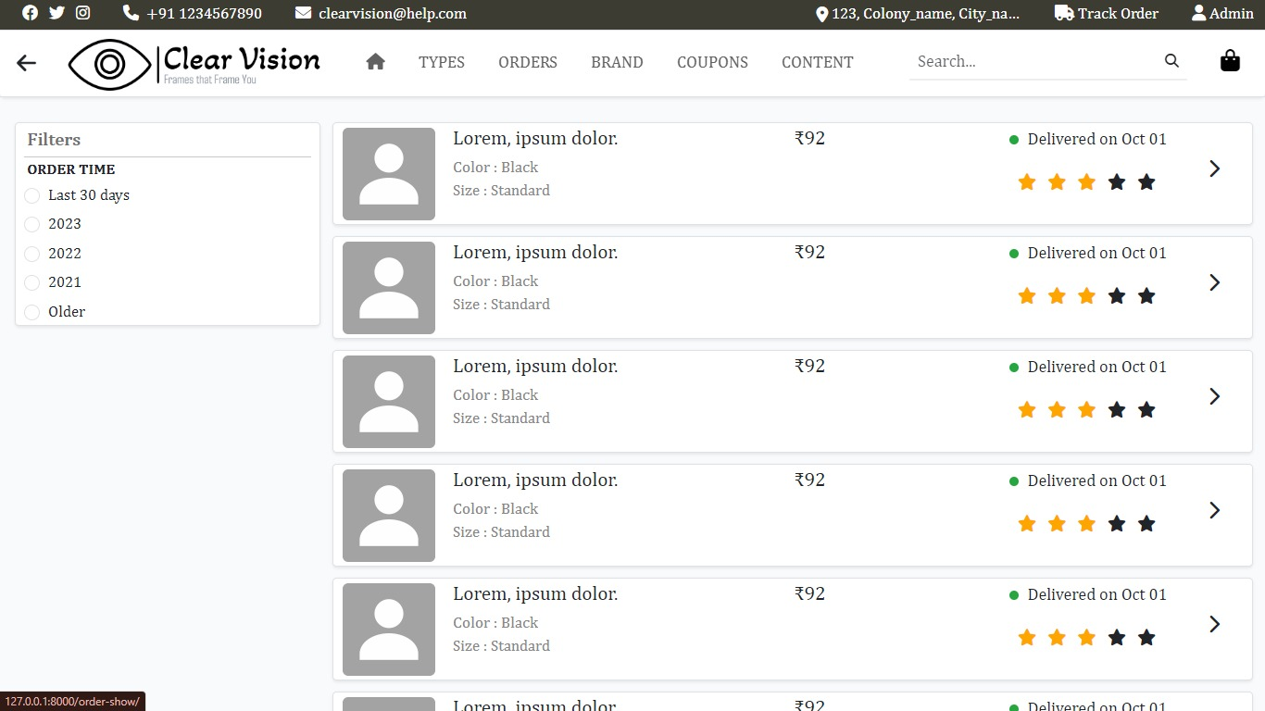
Orders View
Orders details include date, amount ,product details, order time as filters

Slide 10
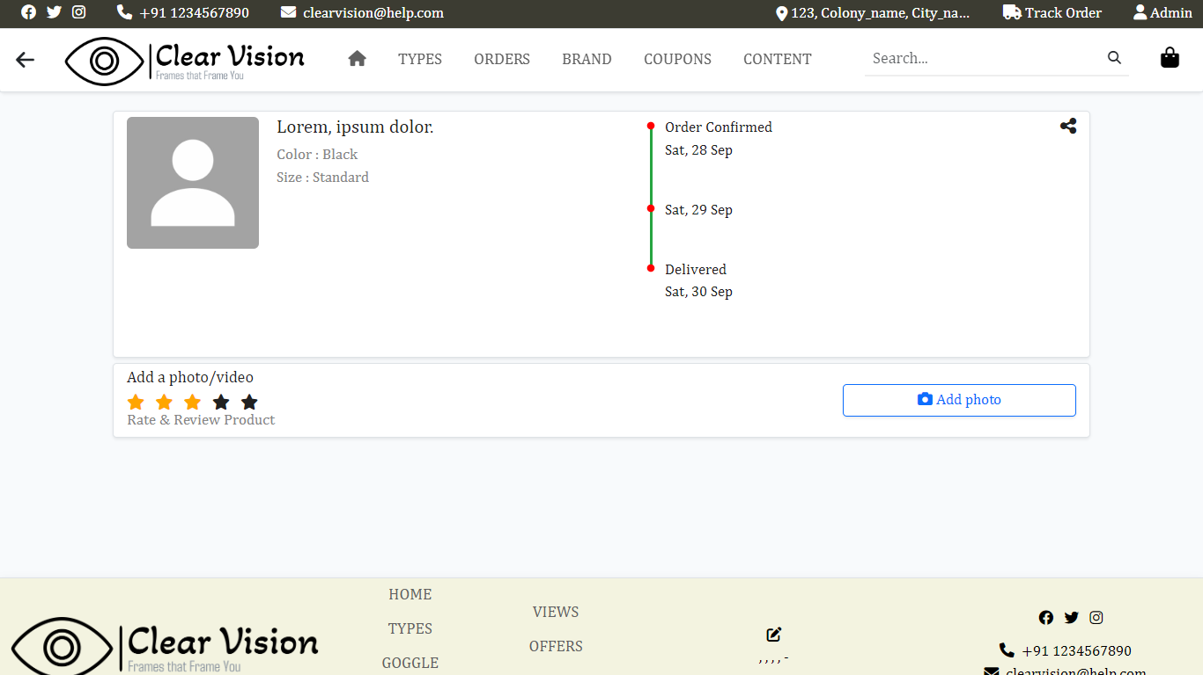
Track Order
You can track you order through this track order interface

Slide 11
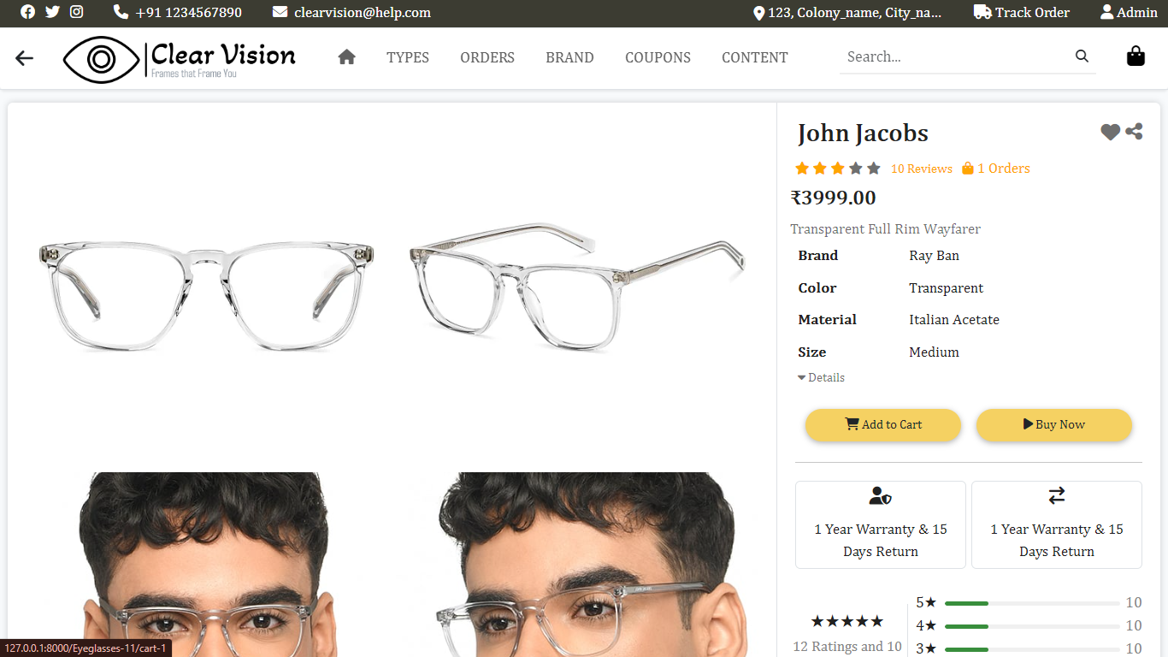
Add-to-Cart
Are product add to cart button and functionalitites

Slide 12
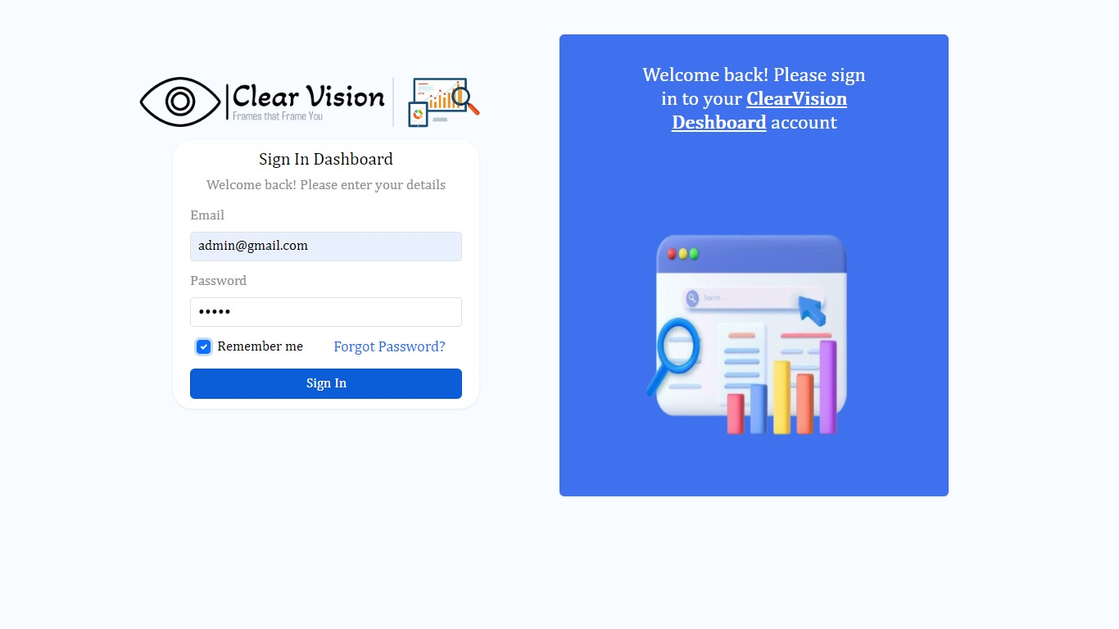
Admin Panel Login
ClearVision admin login page for admin interface include edit and deleting products

Slide 13
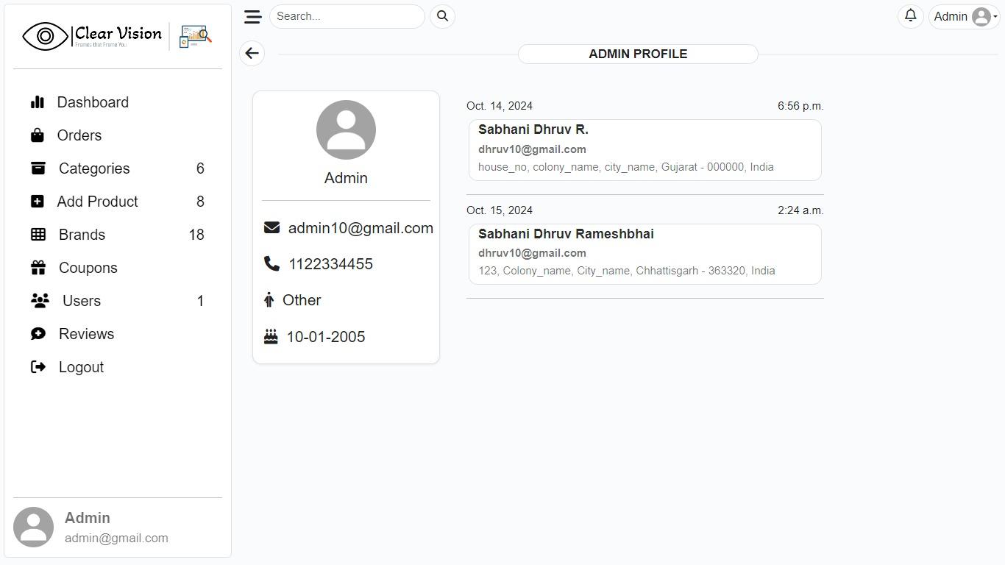
Admin Profile
Admin Profie interface

Slide 14
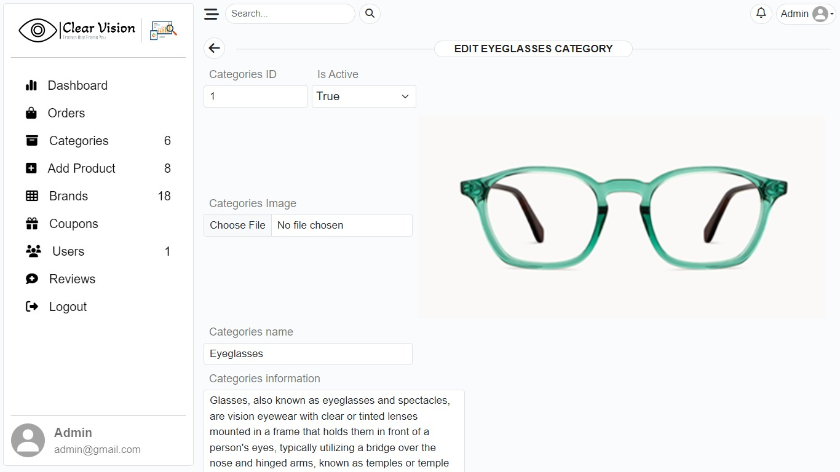
Edit option in Admin
From Admin Site any images or products can be edit through Admin

Slide 15
Thanks

